Slide 1
OneNote
Tech Team Turn-key Presentation

Slide 2
Microsoft OneNote
Waffle
Your Office 365 Cloud Based Digital Notebook for organizing and collaborating

Slide 3
OneNote- at a glance

Slide 4
Agenda
1. Organization and tabs in Notebook
2. Gather and enhance lesson ideas
3. Share with colleagues and students with ease

Slide 5
First up:
Student Notebooks — a private space shared between the teacher and each individual student. Teachers can access every student notebook while students can only see their own.
Content Library — a read-only space where teachers can share handouts with students.
Collaboration Space — a space where everyone in your class can share, organize, and collaborate.
Organization and tabs and setting up your Notebook
You can access a notebook through the waffle or teams.
Each OneNote Class Notebook is organized into three parts:

Slide 6
Set up
Click on waffle
Click on Teams
Go to General Channel on side menu
Add new notebook
Name it

Slide 7
Next up:
Student Notebooks — a private space shared between the teacher and each individual student. Teachers can access every student notebook while students can only see their own.
Content Library — a read-only space where teachers can share handouts with students.
Collaboration Space — a space where everyone in your class can share, organize, and collaborate.
What you can do in each section?

Slide 8
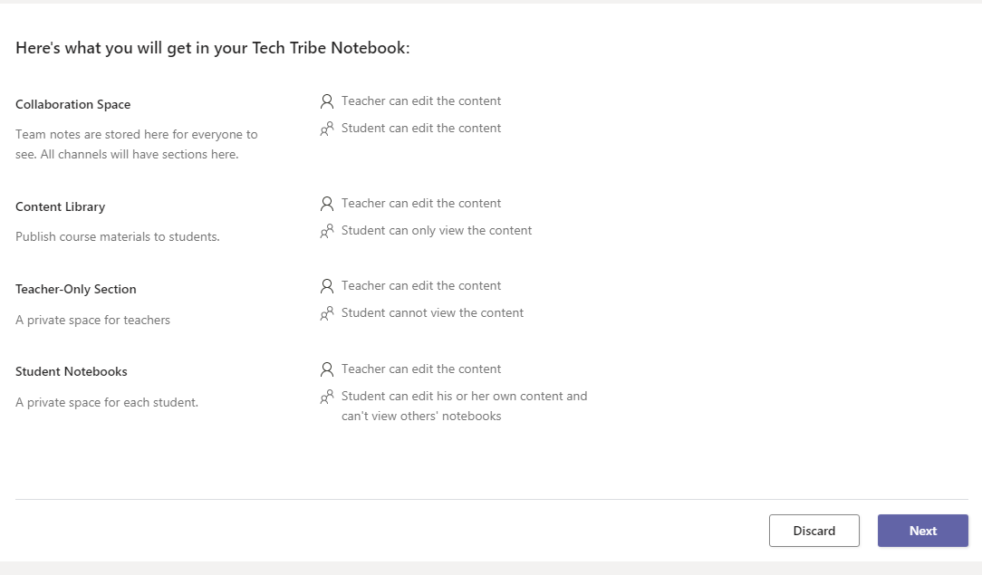
Creating the Notebook
Click on blank notebook
Click next
You will see all the sections that will be displayed
You can personalize now what sections you want with + sign or right click remove the sections

Slide 9
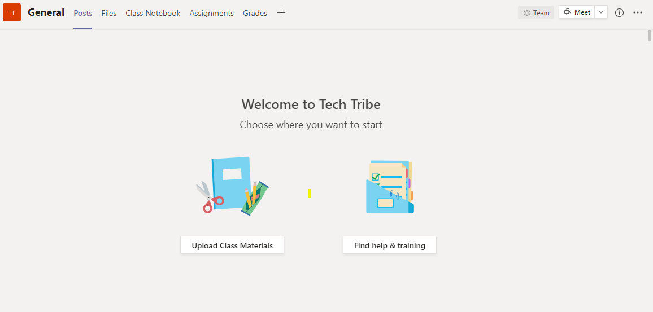
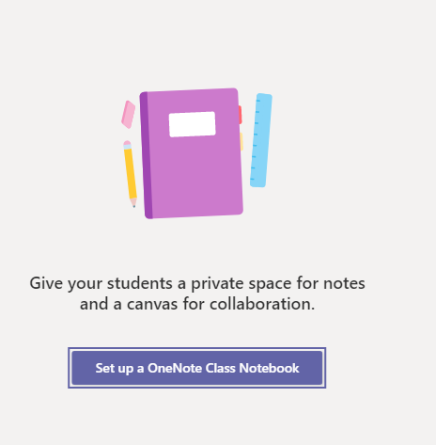
Access:
Click on Class Notebook:
-Set up a OneNote class notebook

Slide 10
Personalize your Notebook sections:
Create
Put in content:

Slide 11
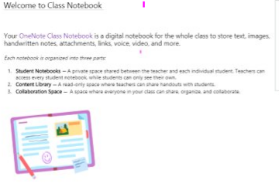
Next Up:
Gathering, Compiling, and Organizing Lesson ideas

Slide 12
Cheat Sheet:

Slide 13
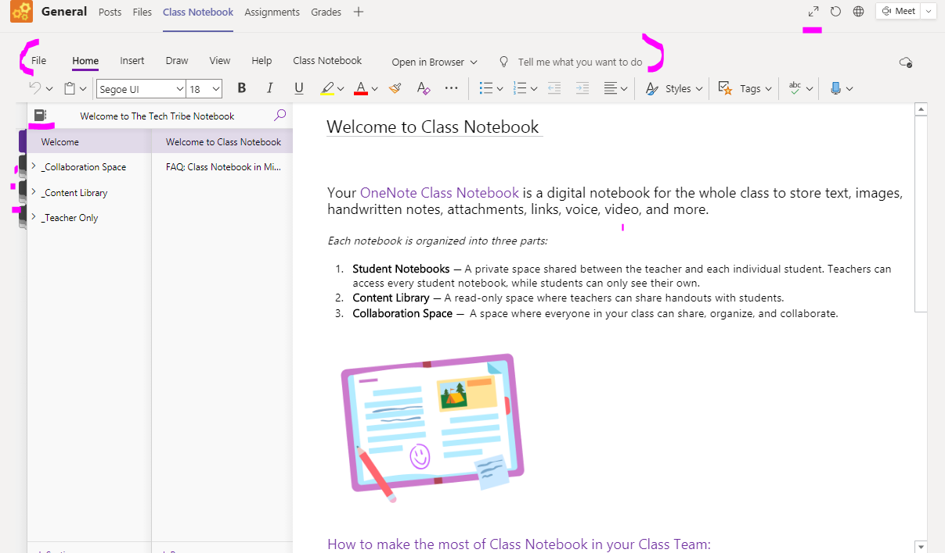
Helpful tools:
Tabs and Tools for formatting
Full Screen
Notebook Sections
Pages
Add Notebook Sections
Add Pages

Slide 14
Home Tab

Slide 15
Time to Check! FolLow this Workflow chart for your first exercise: Using Home tab
Go to Class Notebook
Click on Content Library
Add a page
Title it
Give directions for the assignment or copy an assignment
Change the font size
Change the font style
Change the font color
Center the text
Underline the text

Slide 16
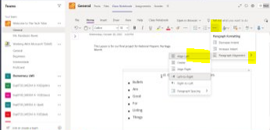
Special Tools
Ellipses- Subscript and Super Subscript
Bullets and managing paragraphs

Slide 17
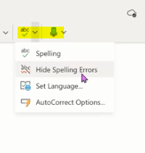
Tags, Spell Check & Dictation
Adding Tags
Spell Check and Dictation- records voice and in different languages right onto page
Set Reminders outside of the text

Slide 18
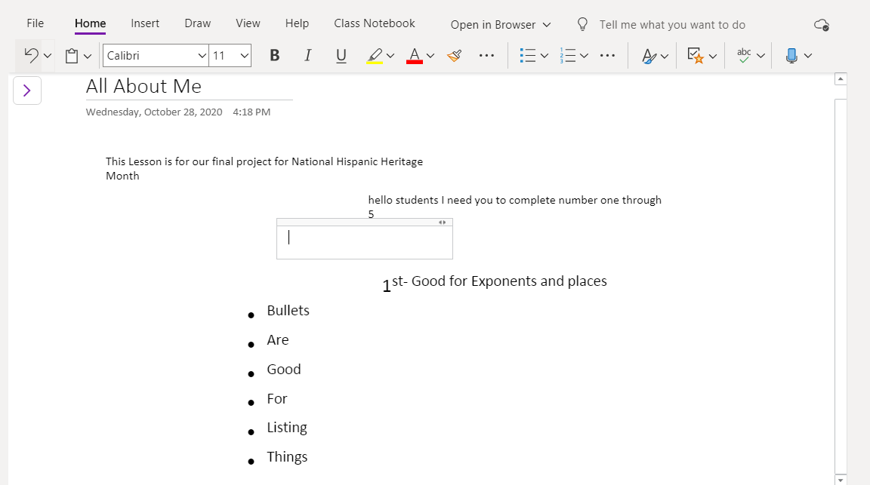
Questions/Time to play
Add content
Add bullets
Center the bullets
Add subscripts
Try dictating text

Slide 19
This and That:
Right click on any page or section at any time to edit
Select text anywhere- and a mini-home-toolbar will appear for quick edits

Slide 20
Next Up- Image Tab
Creating a table
Attaching a file
Insert image
Hyperlink
Video
Symbols
Math Equations
Emogis
And making assessments via notebook with Forms
Create a meeting

Slide 21
Table:
Table comes with a contextual tab that specifically addresses that table, once you tap off the contextual tab disappears, tap back on table to apply changes to the table

Slide 22
Files & Images:
Image comes with a contextual tab that is specific to the picture, it comes up once picture is selected
Images can come from your desktop, camera, or online

Slide 23
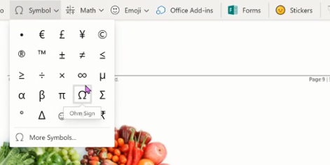
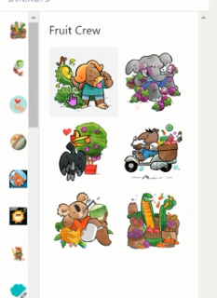
Hyperlinks, Audio & Symbols:
Add Link
Add Audio Recording
Click Audio
Will let you record your voice, not screen
Click links
Copy url
Paste
Name the link
Symbols and Emogi's

Slide 24
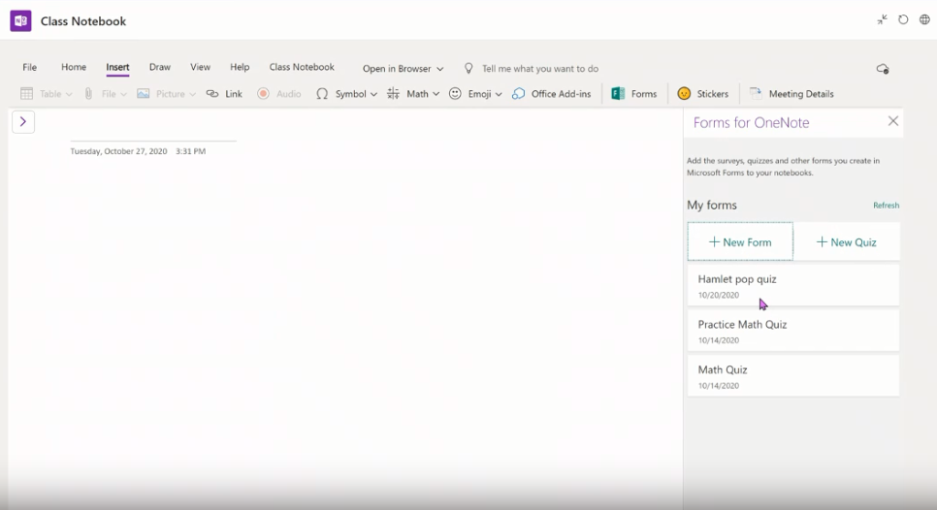
Forms & Add On's:
You can click on Forms and bring in an assesment from the waffle or create on internally on that page.
There are many add on's from the Microsoft Add on store to compliment your lessons
Notes:
You can click on Forms and bring in an assesment from the waffle or create on internally on that page. There are many add on's from the Microsoft Add on store to compliment your lessons

Slide 25
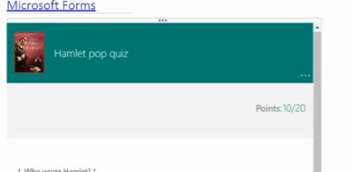
Form appears from your premade- quizzes (in Forms), students take the quiz and it is graded
Form appears from your premade- quizzes (in Forms), students take the assessment and it is graded!

Slide 26
Meeting Details and Syncing Automatically saves:

Slide 27
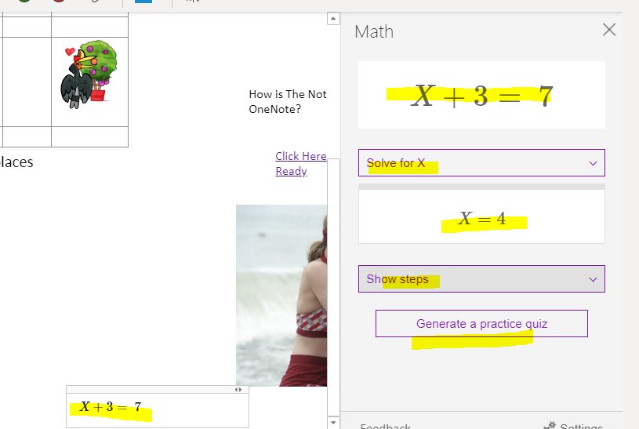
Next Up:
Draw Tool
Math
Click on Math
Type in a problem
Click on Math and it will give you
Answer and suggestions to solve
You have many drawing tools, colors and different widths of pens, can be utilized via the mouse of the touchscreen

Slide 28
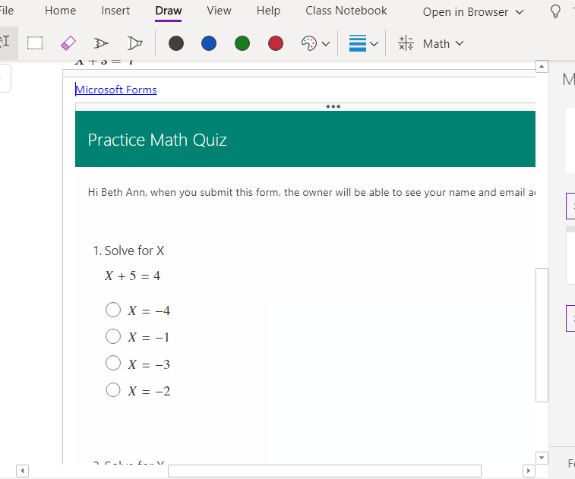
MATH Assessment
Sign into forms and away you go!
Click on Generate a Math Quiz and the Notebook will generate questions around that particular math problem- great for checking for understanding

Slide 29
Questions/Time to Play
Take some time to play with the Draw tab
Ask Questions

Slide 30
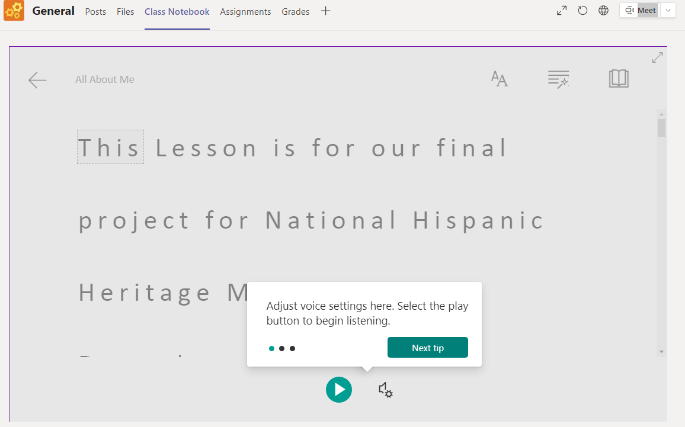
Up Next: View Tab

Slide 31
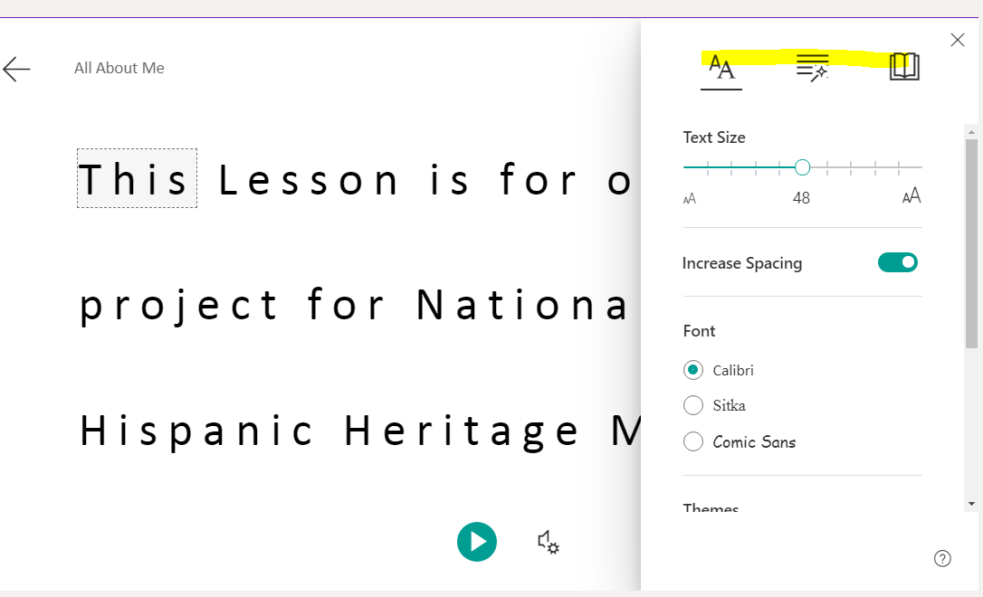
Immersive Reader:
Reads line by line entire page.
can do a line focus,
can color code parts of speech,
add color backgounds,
zoom in and out,
choose language by word or entire document; and
get a definition

Slide 32
Page Color- Changes background Page Versions- Shows you the different versions as you add on Show Authors- Let's you see who posted what Ellipses... Show a timestamp of edits and who contribulted

Slide 33
Get hands-on, interactive training:
Getting Started with Class Notebooks
Need assistance? File a support ticket at:
https://aka.ms/EDUSupport
Suggestions or feedback?
http://onenote.uservoice.com
Join the conversation on social media:
Twitter: @OneNoteEDU and @msonenote
Facebook: OneNote Or reach out to Beth Ann or Stacey
HELP PAGE AND FAQ's

